Slide 1
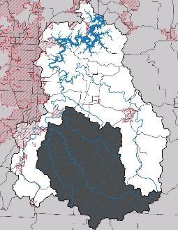
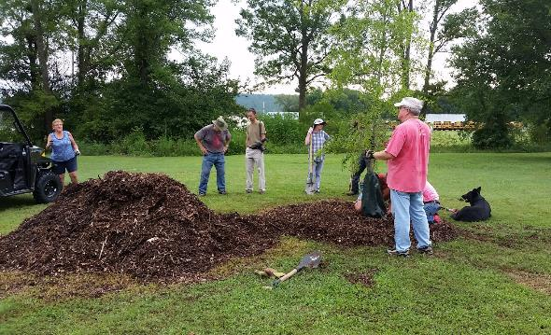



White River and Richland Creek Watershed Opportunity Assessment
Project FY16-500
Melissa Welch

Slide 2
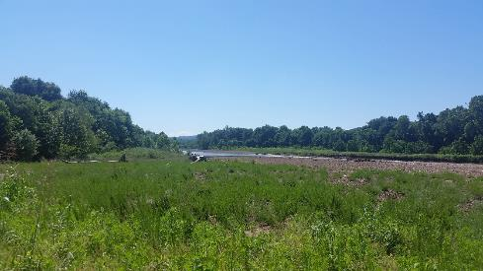
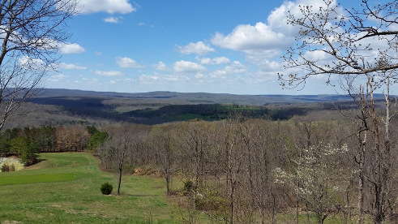
Project Overview
Project Goals/Objectives:
  To raise White River and Richland Creek landowners’ awareness and knowledge of the importance of riparian areas and engage them in adopting individual best management actions through public outreach, education, and demonstration programs.
October 2016 to June 2019
Project Costs: $438,251 (57% Federal, 43% Match)

Slide 3
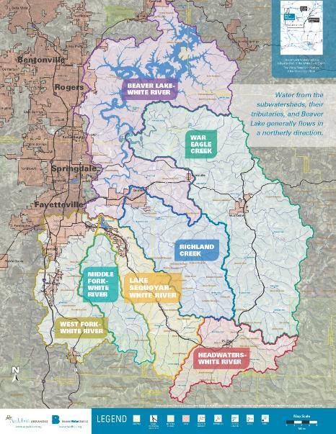
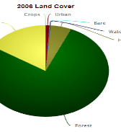
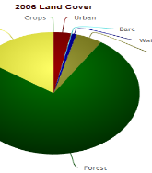
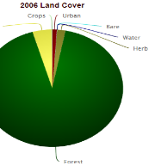
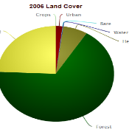
White River-Richland Creek Watershed
Middle Fork-White River
48,410 acres
156.5 mi of roads & 99 mi of streams
Pasture 16%, Forest 77.5%, Urban 1%
Lake Sequoyah-White River
70,838 acres
206 mi of roads &143 mi of streams
490 acre man-made lake (recreational fishing)
Pasture 16%, Forest 75%, Urban 3%
Headwaters-White River
58,206 acres
134 mi of roads & 114.75 mi of streams
Pasture 4.3%, Forest 92.5%, Urban 1%
Richland Creek
93,333 acres
283.3 mi of roads & 189 mi of streams
Pasture 24%, Forest 67%, Urban 2%

Slide 4
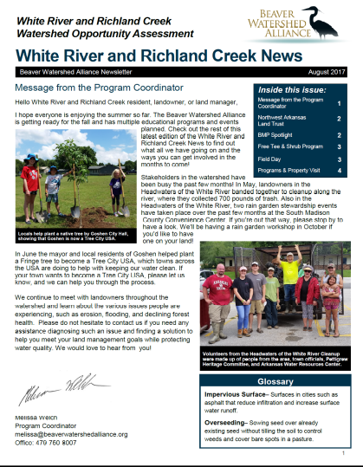
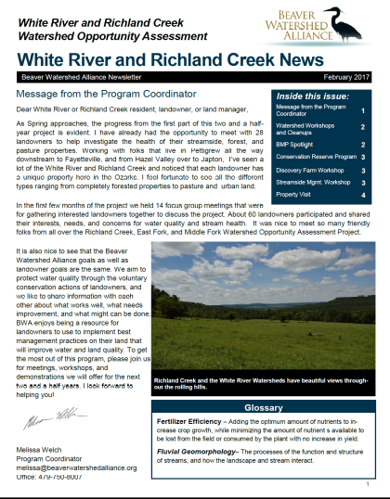
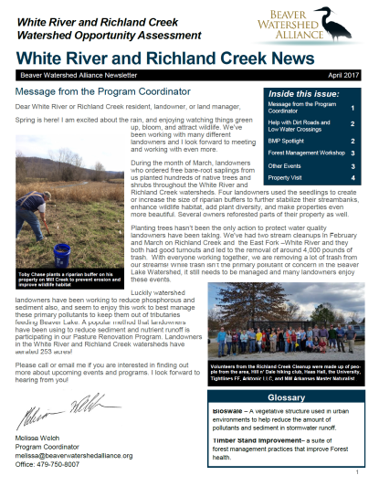
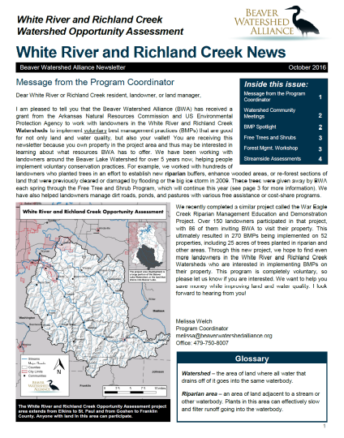
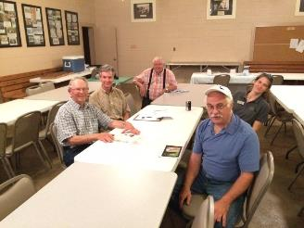
Our Approach
In the beginning
  14 Focus Group Meetings
  Established connections with major stakeholders in watersheds
  47 Attendees
7 bi-monthly newsletters sent to over 4,500 landowners
9 monthly eNews sent to landowners

Slide 5
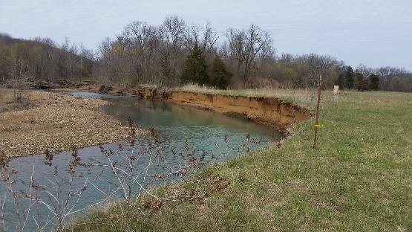
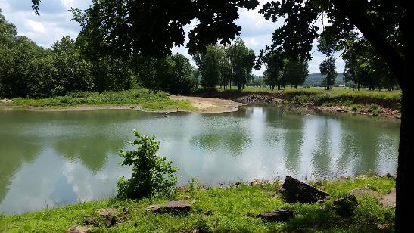
Learning Process
Watersheds have different perspectives
  Headwaters more reserved
  Richland Creek, Lake Sequoyah, and Middle Fork Watershed Landowners more open
  All are excited about protecting water quality
  Why care about Beaver Lake?
    Don’t have rural water

Slide 6
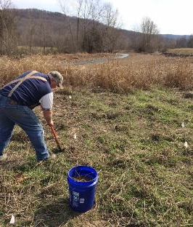
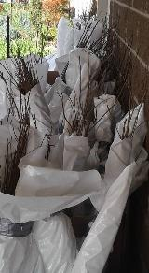
Building Connections
Network of Landowners was Slow Building
  Landowners talked to neighbors
  Some watersheds have closed off communities
Tree and Shrub Program
  Interested the majority of landowners
  30 landowners utilized our bare-root seedling giveaway

Slide 7
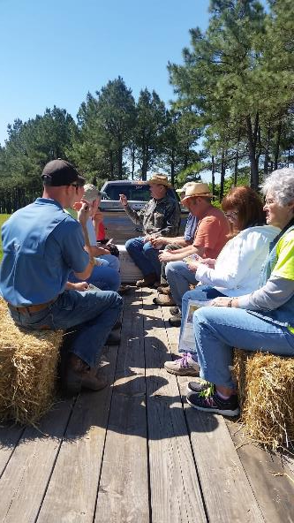
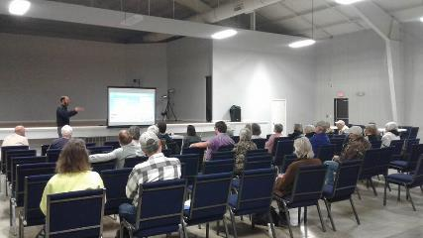
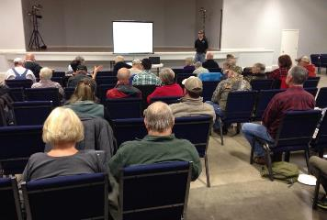
Successful Programs
Forest Management Workshop - December 2016
  44 participants listened to presentations from AGFC, NRCS, and Devereux & Associates LLC
Streamside Management Workshop - March 2017
  50 participants listened to presentations from WCRC, U.S. Fish and Wildlife, and BWA
Forest and Wildlife Management Demo – May 2017
  9 participants learned about thinning and other TSI practices

Slide 8
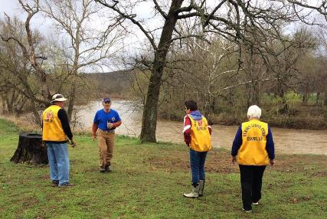
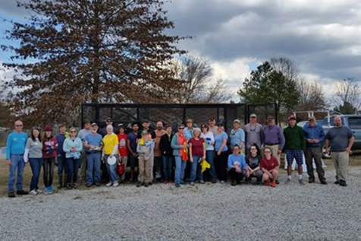
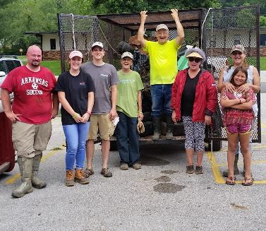
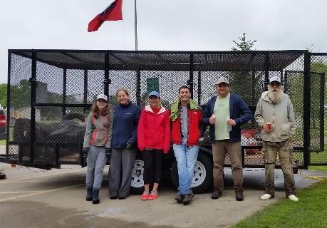
Successful Programs
Five Major Cleanups
  Lake Sequoyah Cleanup
  Richland Creek Cleanup – 2,920 lb
  East Fork-White River Cleanup – 400 lb (20 lb)
  Middle Fork-White River Cleanup – 500 lb (80)
  Headwaters of the White River Cleanup – 700 lb

Slide 9
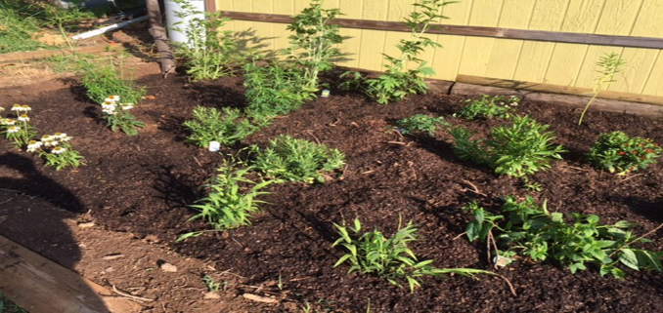
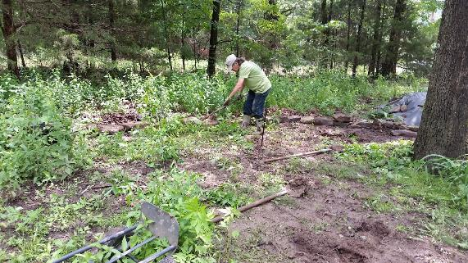
Supplemental Rain Garden Program
Rain Garden Academy- April 2017
  17 participants learned about the rain gardens and how they improve water quality
BWA offered rain garden-mini grants to landowners
  2 landowners in the White River and Richland Creek watersheds applied for funding

Slide 10

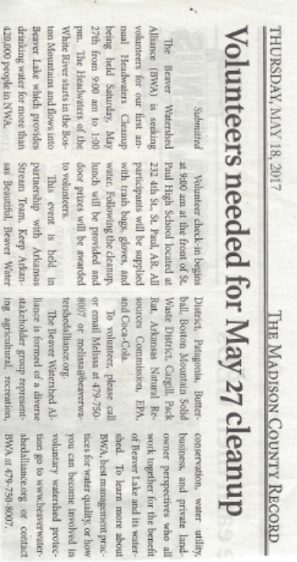
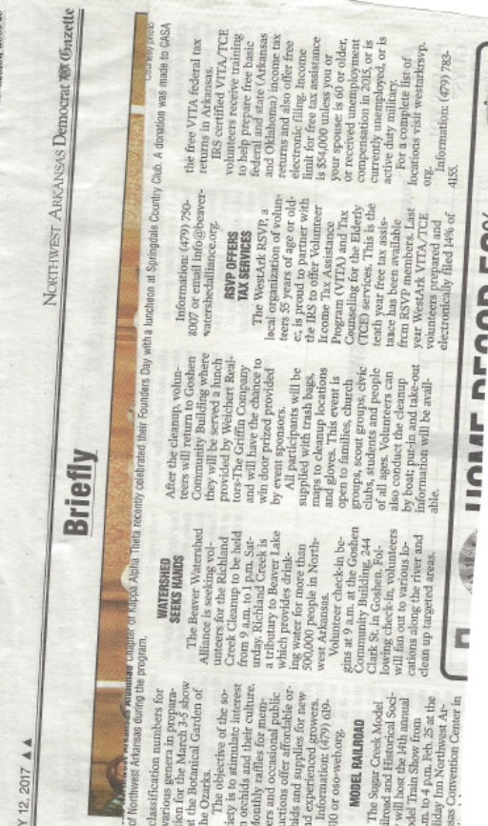
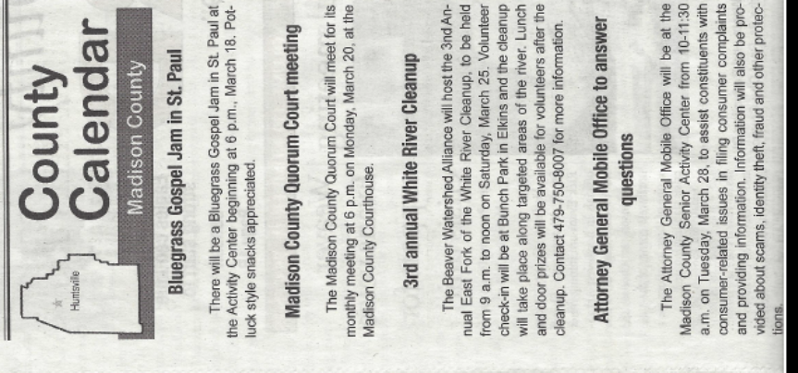
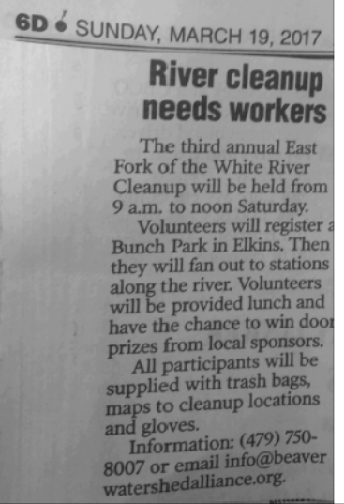
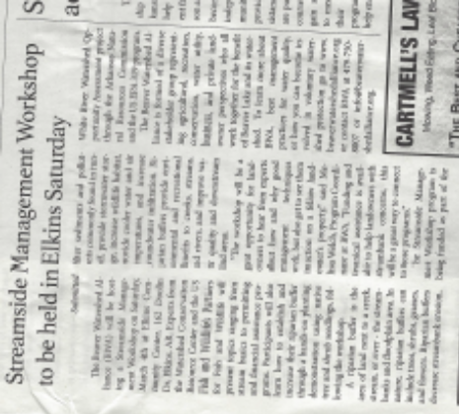
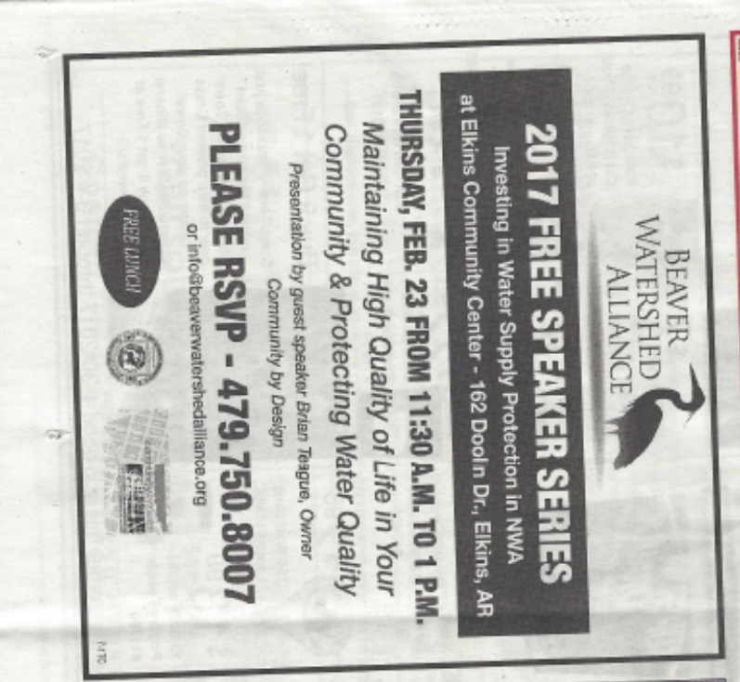

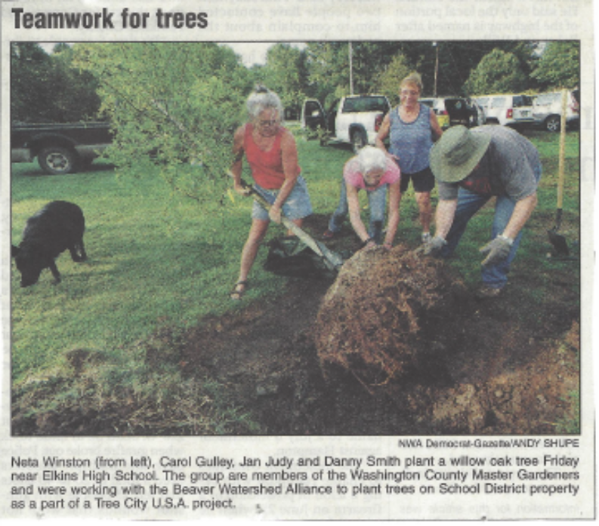
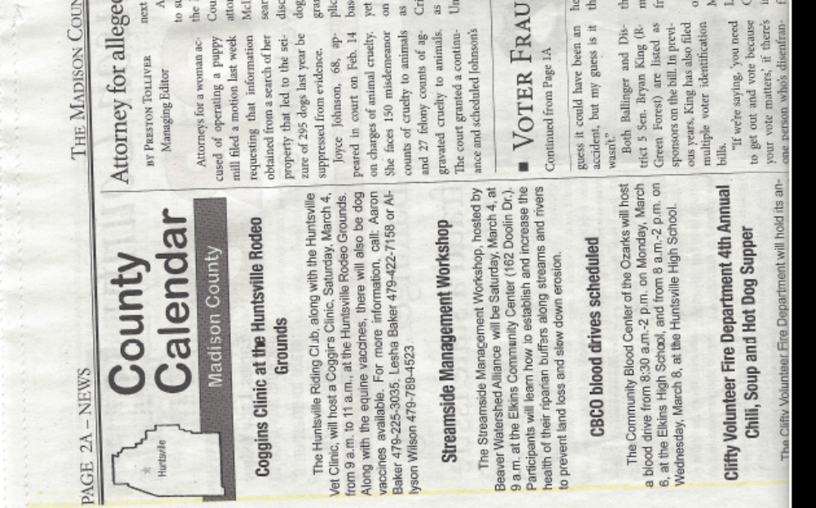
Community Presence

Slide 11
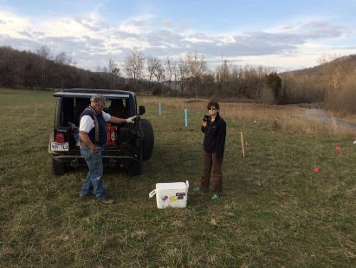
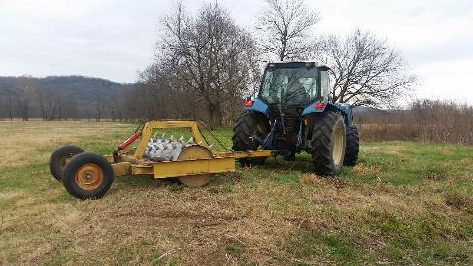
Project Numbers So Far
536 Participating Landowners
64 Site Assessments
136 BMPs Implemented
  1,005 acres Aerated
  7 acres of Riparian Buffer Established
  61 acres of Upland Habitat Reforested
26 Demonstration Sites Established
Open-Space Neighborhood Collaboration

Slide 12
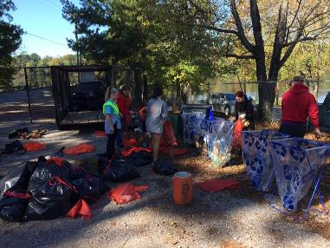
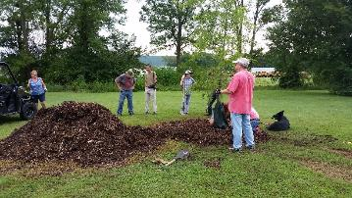
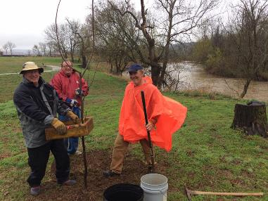
Project Numbers So Far
751.75 Volunteer Hours
  About $17,700 of $50,000 needed
3 Special Interest Meetings
5 Stream Cleanups
9 Native Tree Plantings
7 Newsletters and 15 Mass Mailings
4 Rain Garden Stewardship Events

Slide 13
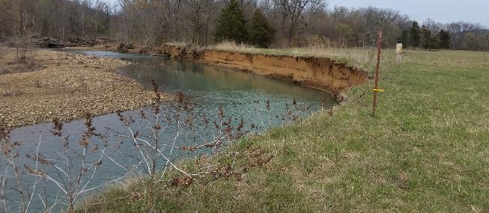
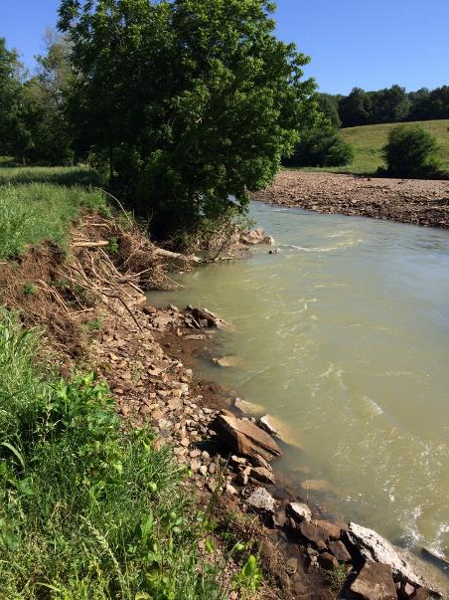
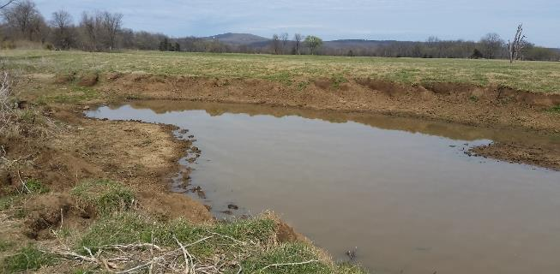
Big Issues

Slide 14
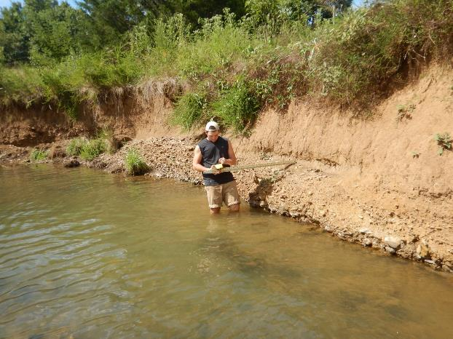
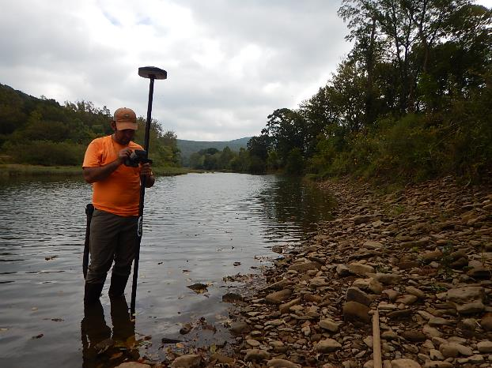
Erosion Estimates

Slide 15
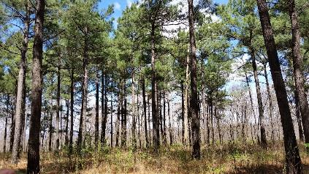
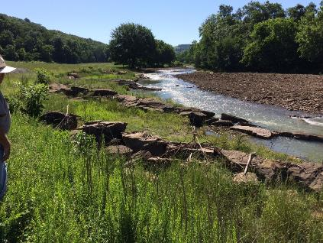
Rounding the Corner
Snowball Effect
  More Site Visits
Increasing the Number of Demonstration Sites
More Programs Planned:
  Forest Management Workshop
  Beaver Lake Watershed Symposium
  Streamside Management Workshop
  10 WROA Meetings
    Maps being made
    Areas not being reached?

Slide 16























Thanks to Our Partners & Sponsors:

